Slide 1
Cox Regression and other ways to survive survival analyses
May 13, 2024

Slide 2

Very Important Disclaimers
I’m a generalist statistician, so please don’t consider my statements definitive
Doing your own reading is encouraged
This is based on an in-house presentation for my group on using Cox regression
This is based on my own experience with Cox models, so may not be comprehensive

Slide 3
Goals
What is Cox Proportional Hazards Regression?
How is it used and interpreted?
How do you check that the model is good?
Assumptions
Performance
Routine Use
Special Cases
Correlated data
Time-varying
Competing risks

Slide 4
What is Cox Proportional Hazards Regression?

Slide 5
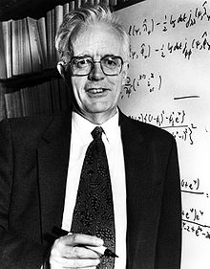
The Cox in Cox Proportional Hazards regression
Sir David Roxbee Cox FRS FBA FRSE (15 July 1924 – 18 January 2022)
Contributions include
Box-Cox transform (to satisfy assumptions of linear regression, 1964)
Logistic regression (1958)
Cox Proportional Hazards Regression (1972)
https://en.wikipedia.org/wiki/David_Cox_(statistician)

Slide 6
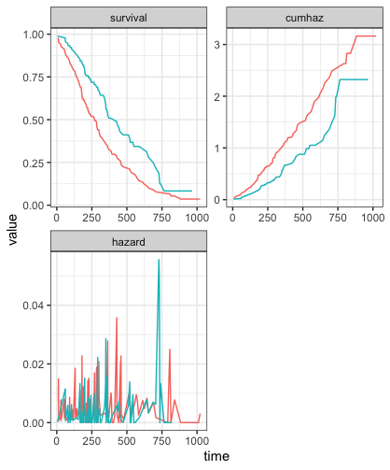
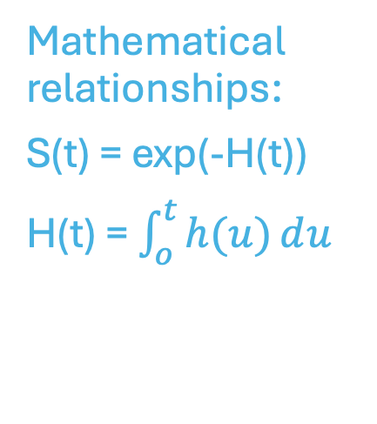
The Hazard in Cox Proportional Hazards Regression
Survival function S(t) is the probability that the patient will not have had the event by a given time
Hazard function h(t) is the instantaneous probability for the event, tends to be noisy
Cumulative Hazard H(t) is the integral of the hazard function
Mathematical relationships:
S(t) = exp(-H(t))
H(t) = $\int_{o}^{t}{h(u)ⅆu}$

Slide 7
The Proportion in Cox Proportional Hazards Regression
The Cox model for the i^{th} individual in a set can be written as h_{i}(t) = exp(βx_{i})*h_{o}(t) where:
x_{i} is the set of predictor values for the i^{th} individual
β is the set of parameters describing the effect of x
h_{o}(t)is the baseline hazard function, when all values of x_{i} are zero
Like a regression equation except no intercept
The Cox model is semiparametric because h_{o}(t)is non-parametric

Slide 8
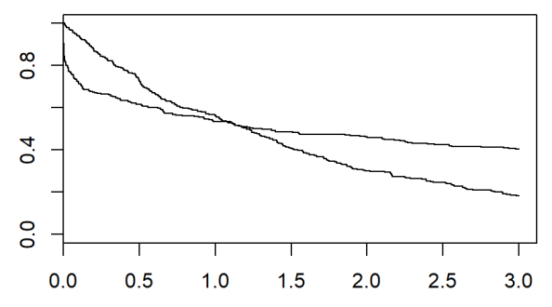
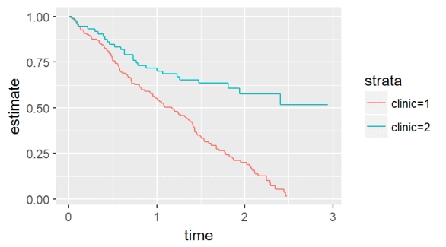
Example failures of Proportional Hazards assumption
Sample KM plots from
https://www.theanalysisfactor.com/assumptions-cox-regression/
Crossing – not proportional
One curve plateaus, other keeps going

Slide 9
R resources for Cox models
Survival package, written by Terry Therneau
Functions | Vignettes (selection)
coxph: do the regression cox.zph: test the proportional hazards assumption (residuals vs expectation) concordance: assess predictive power | survival: includes review of recurrent events and competing risks timedep: “Using Time Dependent Covariates and Time Dependent Coeffcients in the Cox Model” splines: “Spline terms in a Cox model”
Other packages
survminer making survival analyses more attractive and/or informative coxme: add mixed effects survey: options for IPW-weighted Cox models and Kaplan-Meier curves | rms: assessing predictive power and accuracy of assumptions Part of the “Harrelverse” CRAN task view for Survival Analysis

Slide 10
How is Cox regression used and interpreted?

Slide 11
Why do a regression?
Explanatory | Identify features which have the greatest impact on outcome (Hazard Ratios) | Most commonly seen use of Cox regression
Predictive | For a defined (known, hypothetical) patient or set of patients, estimate the probable outcomes | Charlson index based on Cox regression coefficients

Slide 12
Why Cox model?
Options for event data
Logistic | Probability of event happening at all | Odds Ratios | Assumes all patients have same opportunity to get event (fixed time window)
Count Data (Poisson or negative binomial) | Expected rate of events over time | Rate Ratios | Assumes equal hazard across time span
Survival analyses | Cumulative survival over time | Hazard Ratios | Allows for “censored” data occurring after observation stops

Slide 13
Hazard Ratios from Cox regression
Cox models will return parameters which are the log of hazard ratios
CI’s for log HR can come from either the reported SE or using confint in R
HR <1 (log HR < 0) means less risk, HR >1 (log HR > 0) more
Conditional logistic regression (clogit in ‘survival’) is implemented by Cox model
Hazard ratios like odds ratios in logistic regression

Slide 14
Info from coxph call
Exp(coef) is the Hazard Ratio
Exp(-coef) is the inverse Hazard Ratio
Concordance is the probability that for any pair of individuals, if one of the pair has a greater predicted survival time, it will also have a greater observed survival time.
> summary(coxph(formula = Surv(time, status) ~ sex, data = lung))
Call:
coxph(formula = Surv(time, status) ~ sex, data = lung)
n= 228, number of events= 165
coef exp(coef) se(coef) z Pr(>|z|)
sex -0.5310 0.5880 0.1672 -3.176 0.00149 **
---
Signif. codes: 0 ‘***’ 0.001 ‘**’ 0.01 ‘*’ 0.05 ‘.’ 0.1 ‘ ’ 1
exp(coef) exp(-coef) lower .95 upper .95
sex 0.588 1.701 0.4237 0.816
Concordance= 0.579 (se = 0.021 )
Likelihood ratio test= 10.63 on 1 df, p=0.001
Wald test = 10.09 on 1 df, p=0.001
Score (logrank) test = 10.33 on 1 df, p=0.001
Under concordance are three estimates of the p-value. The Wald estimate is the one under Pr(>|z|). The Likelihood ratio test has better behavior for small samples. For large samples, all three should agree.

Slide 15
Notes on statistical power
Power is of primary use for planning prospective studies. For database/ retrospective studies, sample size is fixed. Confidence intervals can be used to consider whether study underpowered.
‘powerSurvEpi’ will calculate power for a Cox model with a binary variable of primary interest and one other covariate which may or may not be binary
‘simstudy’ can be used to look at power through simulating data and statistical tests. Can be used for more complicated models.

Slide 16
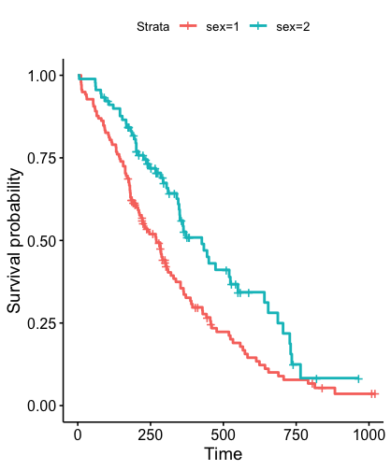
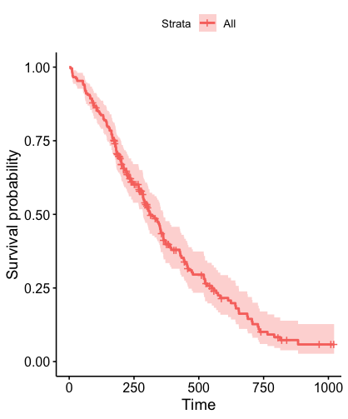
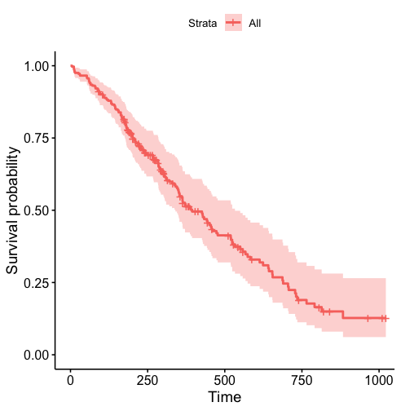
Survival curve from Cox regression
survfit in ‘survival’ package returns curve for the Cox model at specific covariate values
Sex = 1
Sex = 2
The ‘survminer’ package is a good way to format plots. It also allows options for generating adjusted curves, following vignette in ‘survival’ package.

Slide 17
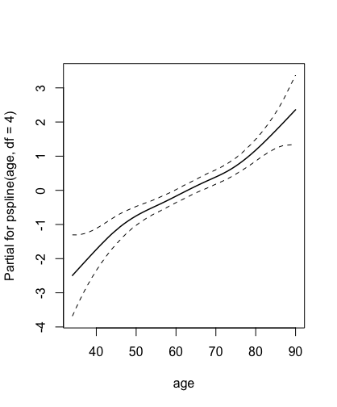
Continuous predictors
Cox model allows use of continuous predictors and Hazard Ratio per unit of predictor.
As with other regressions, possible non-linear relationships can be accounted for by using polynomial terms or by using splines.
Termplot function (see ‘splines’ vignette in ‘survival package) can be used to extract log-odds vs variable for spline terms
Extracted spline functions may not be centered (log-odds = 0) at preferred reference value but can add offset term to change that.

Slide 18
Which Predictors to Use?
Feature selection is a general problem in regression models
Lasso methods are good if the problem needs to be automated (many features or many models)
AIC or BIC can be used in smaller problems and allow consideration of the consequence of removing each parameter. Some parameters you may want to leave because they are relevant to a research question.

Slide 19
Special Cases
Correlated data | No independence between measurements from same person/group
Time-varying predictors | Predictors are not constant but change over the time interval
Competing risks | Something else can happen to the patient (death vs remission or recurrence)

Slide 20
Correlated Data
Regression models assume each record is independent
If records correlated
The 'coxme' package offers better algorithm for frailty (same author as 'survival')
The frailty option introduces a random effect as in mixed models
The cluster option is comparable to a GEE

Slide 21
Time-varying predictors
Time-varying predictors used by dividing into chunks and clustering on patient id. Then use Cox model as before with start and stop times.
Cox model also includes possible definition of time-transform functions for variables that have different effects over time.
coxph(Surv(tstart, tstop, infect) ~ treat + inherit + steroids, data =newcgd, cluster = id)
id treat sex age futime tstart tstop infect enum
1 1 1 2 12 414 0 219 1 1
2 1 1 2 12 414 219 373 1 2
3 1 1 2 12 414 373 414 0 3
4 2 0 1 15 439 0 8 1 1
5 2 0 1 15 439 8 26 1 2
6 2 0 1 15 439 26 152 1 3

Slide 22
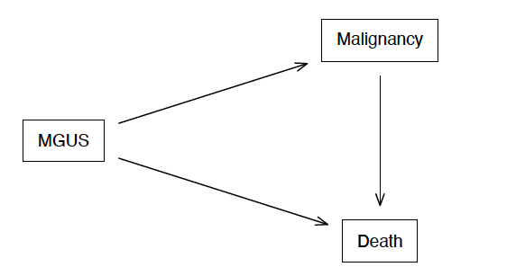
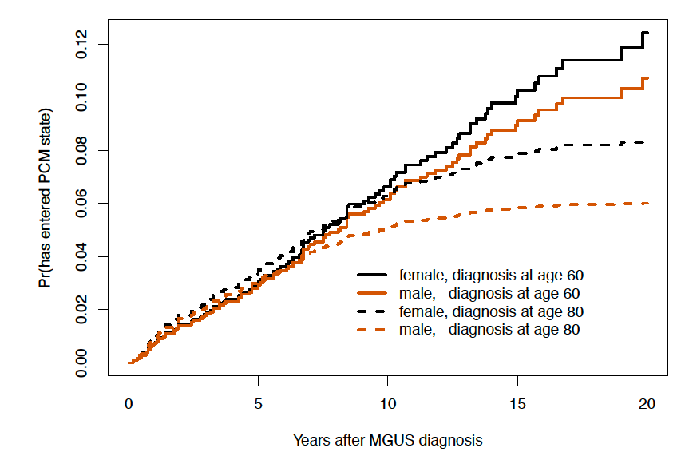
Competing risks
Death is a common example of competing risk with outcome of interest. If they’ve had the competing risk, no longer possible to have the event of interest – but they could have had it!
Survival analyses in R allow for multiple outcome states – convention is censored 0, primary 1, secondary 2
From survival vignette
Cumulative incidence is the % of people who have had event (in simple case, 1 – KM)

Slide 23
Competing methods? The Fine-Gray approach to competing risk
The Fine-Gray approach is another way to do competing risks. It’s a variation of Cox model, also assuming competing hazards
It is implemented in the cmprsk package, written by Gray, and also has an implementation in survival
Compete vignette in survival goes into more detail on competing risk approaches and has some criticism of F-G method but does say it gives “simple and digestible” descriptions of lifetime risk

Slide 24
How do you check the model?

Slide 25
Assumptions of Proportional Hazards model
The first assumption of the PH model is that the predictor has a multiplicative effect on the hazard that is constant over time
The hazard itself does not have to be constant over time, but the proportionality must be constant

Slide 26
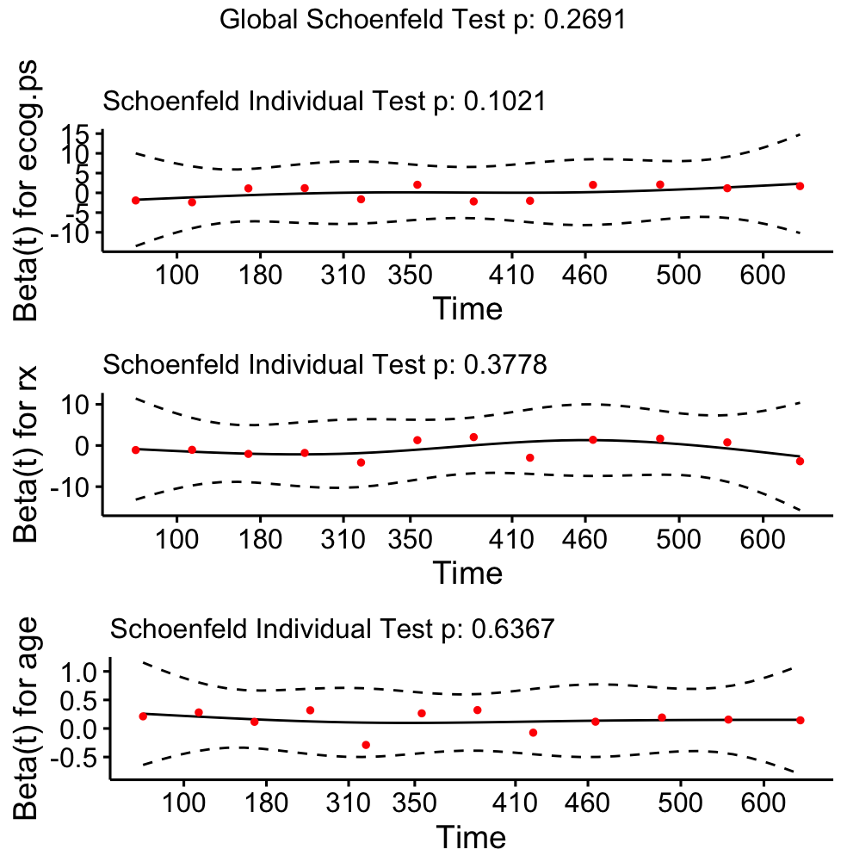
Testing proportional hazard assumption
Cox.zph function in ‘survival’ examines whether the effect of a predictor is constant over time.
It will work with models from the ‘survival’, ‘rms’ or ‘coxme’ packages.
Plot uses the ‘survminer’ package

Slide 27
Fixes for significant cox.zph test
This significance test may be affected by the sample size = for large N even negligible effects can be significant
If cox.zph shows something is significant, options include:
Use the Cox model as-is, benefitting from the clarity of the model, but discuss the caveat
Use strata() in survival to account for the variables properly, but they will no longer be visible in the Cox model
Use a parametric survival regression (next slide)

Slide 28
Parametric survival regression
survreg in ‘survival’ is one way to generate accelerated failure time models, which assume a distribution of times to failure
An increasing parameter that the patient takes more time to have the event, as opposed to Cox model where it means greater risk of having event
Different distributions can be compared using model AIC

Slide 29
Checking the model for predictive accuracy
Validation | Concordance between prediction and observation | Break linear predictor (βx) into quartiles and compare resulting survival curves | Use bootstraps to refit model and check for consistent performance | New model with linear predictor as sole predictor, check whether log HR is 1.0
Internal (same data used to create model) | X | X | X
External (new data) | X | X |  | X

Slide 30
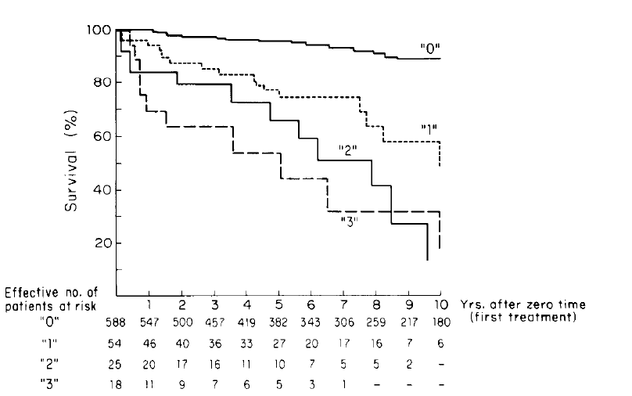
Example Validation (Charlson, 1987)

Slide 31
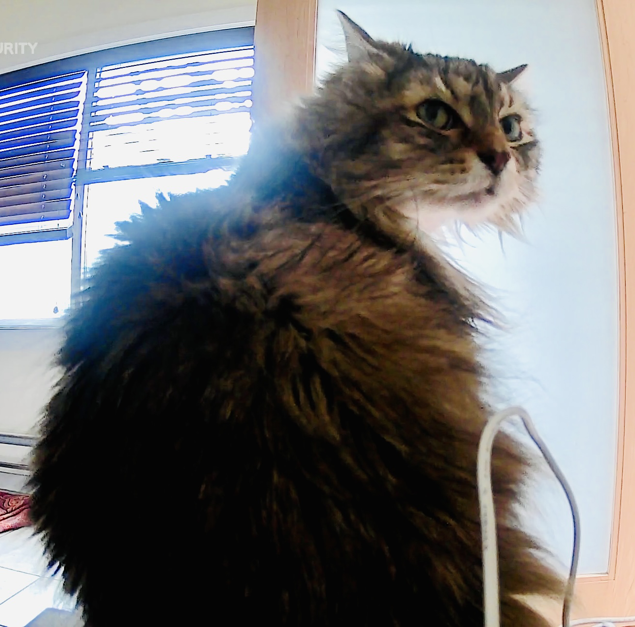
Remember: Oscar doesn’t care

